Slide 1

1.1 Setting Up the Python Environment
© London Academy of IT, www.londonacademyofit.co.uk

Slide 2
Data Science With Python
Python distributions
Jupyter notebook
Notebook basics
Project template
Versioning system

Slide 3





Python Distributions
Option -1
Option -2
Packages
Base Python

Slide 4
Python Distributions for Data Science
Anaconda
Enthought canopy

Slide 5
Anaconda Distribution
Anaconda Distribution
Free version
Python 2.x & 3.x

Slide 6
Python 2.x VS 3.x
Python 3.x
Clean & Faster
Future
Python 2.x
Stable 3rd party packages
Better community support
Backward compatibility

Slide 7

Anaconda Installation
Anaconda Installation Demo

Slide 8

Jupyter Notebook
Known as IPython Notebook
Combine code blocks, text, pictures, videos in a single document
Web GUI based
Work with multiple kernels such as Python, Scala, R and Julia
Easy to export the document as PDF

Slide 9
Jupyter Notebook - Demo

Slide 10
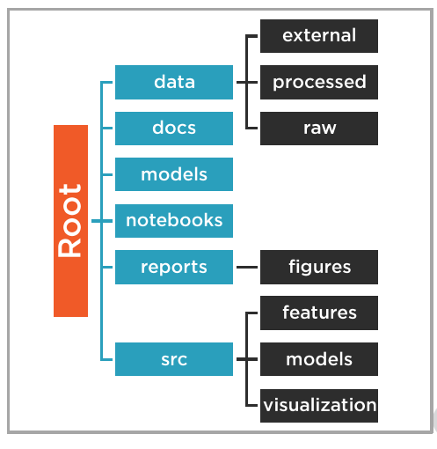
Data Science Project Template
Data Science Project Template

Slide 11
Advantage of using Project Template
Consistency
Standardization
Collaboration
Reusability
Code quality

Slide 12

Python Project Template
Cookie Cutter Project Template
https://bit.ly/2sQqk49
(https://github.com/drivendata/cookiecutter-data-science)

Slide 13
Jupyter Notebook – Cookie Cutter Demo

Slide 14
Data Science With Python - Versioning
Common repository
Track changes
Suitable for individuals

Slide 15



Data Science With Python - Versioning
Local
Git
Cloud
GitHub
Bitbucket

